Slide 1

UNIVERSITY INSTITUTE OF ENGINEERING
COMPUTER SCIENCE ENGINEERING
ARTIFICIAL INTELLIGENCE
(21CSH-611/621)
INTRODUCTION
DISCOVER . LEARN . EMPOWER

Slide 2
RBFS
Recursive Best First Search
Linear space variant of A*
Perform A* search but discard subtrees when perform recursion
Keep track of alternative (next best) subtree
Expand subtree until f value greater than bound
Update f values before (from parent) and after (from descendant) recursive call

Slide 3
Algorithm
// Input is current node and f limit
// Returns goal node or failure, updated limit
RBFS(n, limit)
if Goal(n)
return n
children = Expand(n)
if children empty
return failure, infinity
for each c in children
f[c] = max(g(c)+h(c), f[n]) // Update f[c] based on parent
repeat
best = child with smallest f value
if f[best] > limit
return failure, f[best]
alternative = second-lowest f-value among children
newlimit = min(limit, alternative)
result, f[best] = RBFS(best, newlimit) // Update f[best] based on descendant
if result not equal to failure
return result

Slide 4
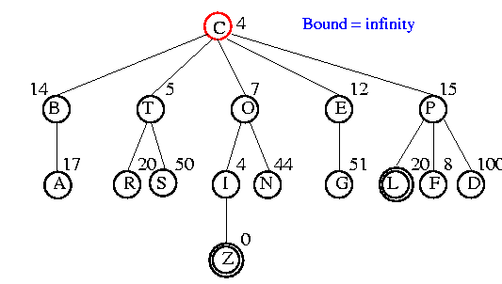
Example

Slide 5
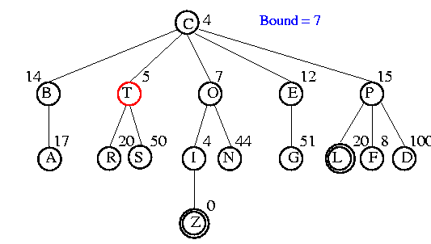
Example

Slide 6
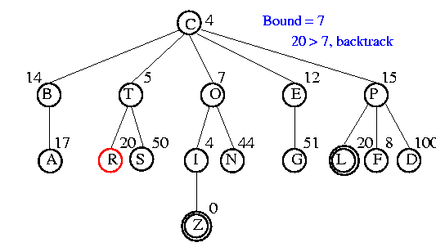
Example

Slide 7
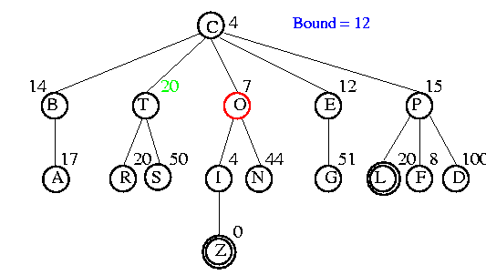
Example

Slide 8
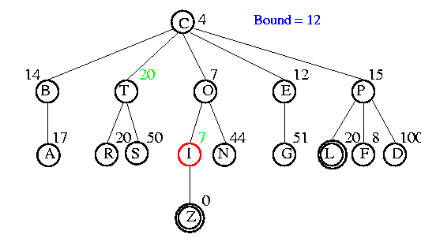
Example

Slide 9
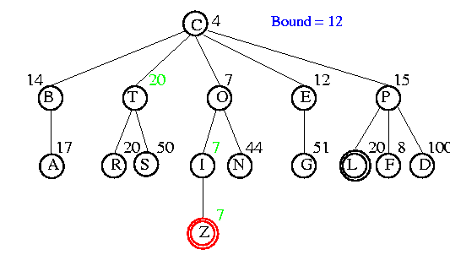
Example

Slide 10
Analysis
Optimal if h(n) is admissible
Space is O(bm)
Features
Potentially exponential time in cost of solution
More efficient than IDA*
Keeps more information than IDA* but benefits from storing this information

Slide 11
Iterative Improvement Algorithms
Hill climbing
Simulated annealing
Genetic algorithms

Slide 12
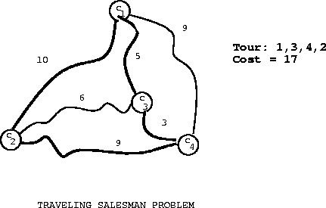
Example
Traveling salesman
Start with any complete tour
Operator: Perform pairwise exchanges

Slide 13

Example
N-queens
Put n queens on an n × n board with no two queens on the same row, column, or diagonal
Operator: Move queen to reduce #conflicts

Slide 14
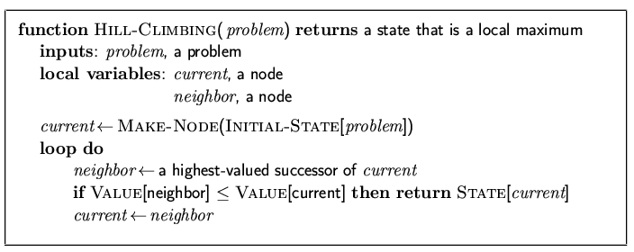
Hill Climbing (gradient ascent/descent)
“Like climbing Mount Everest in thick fog with amnesia”

Slide 15
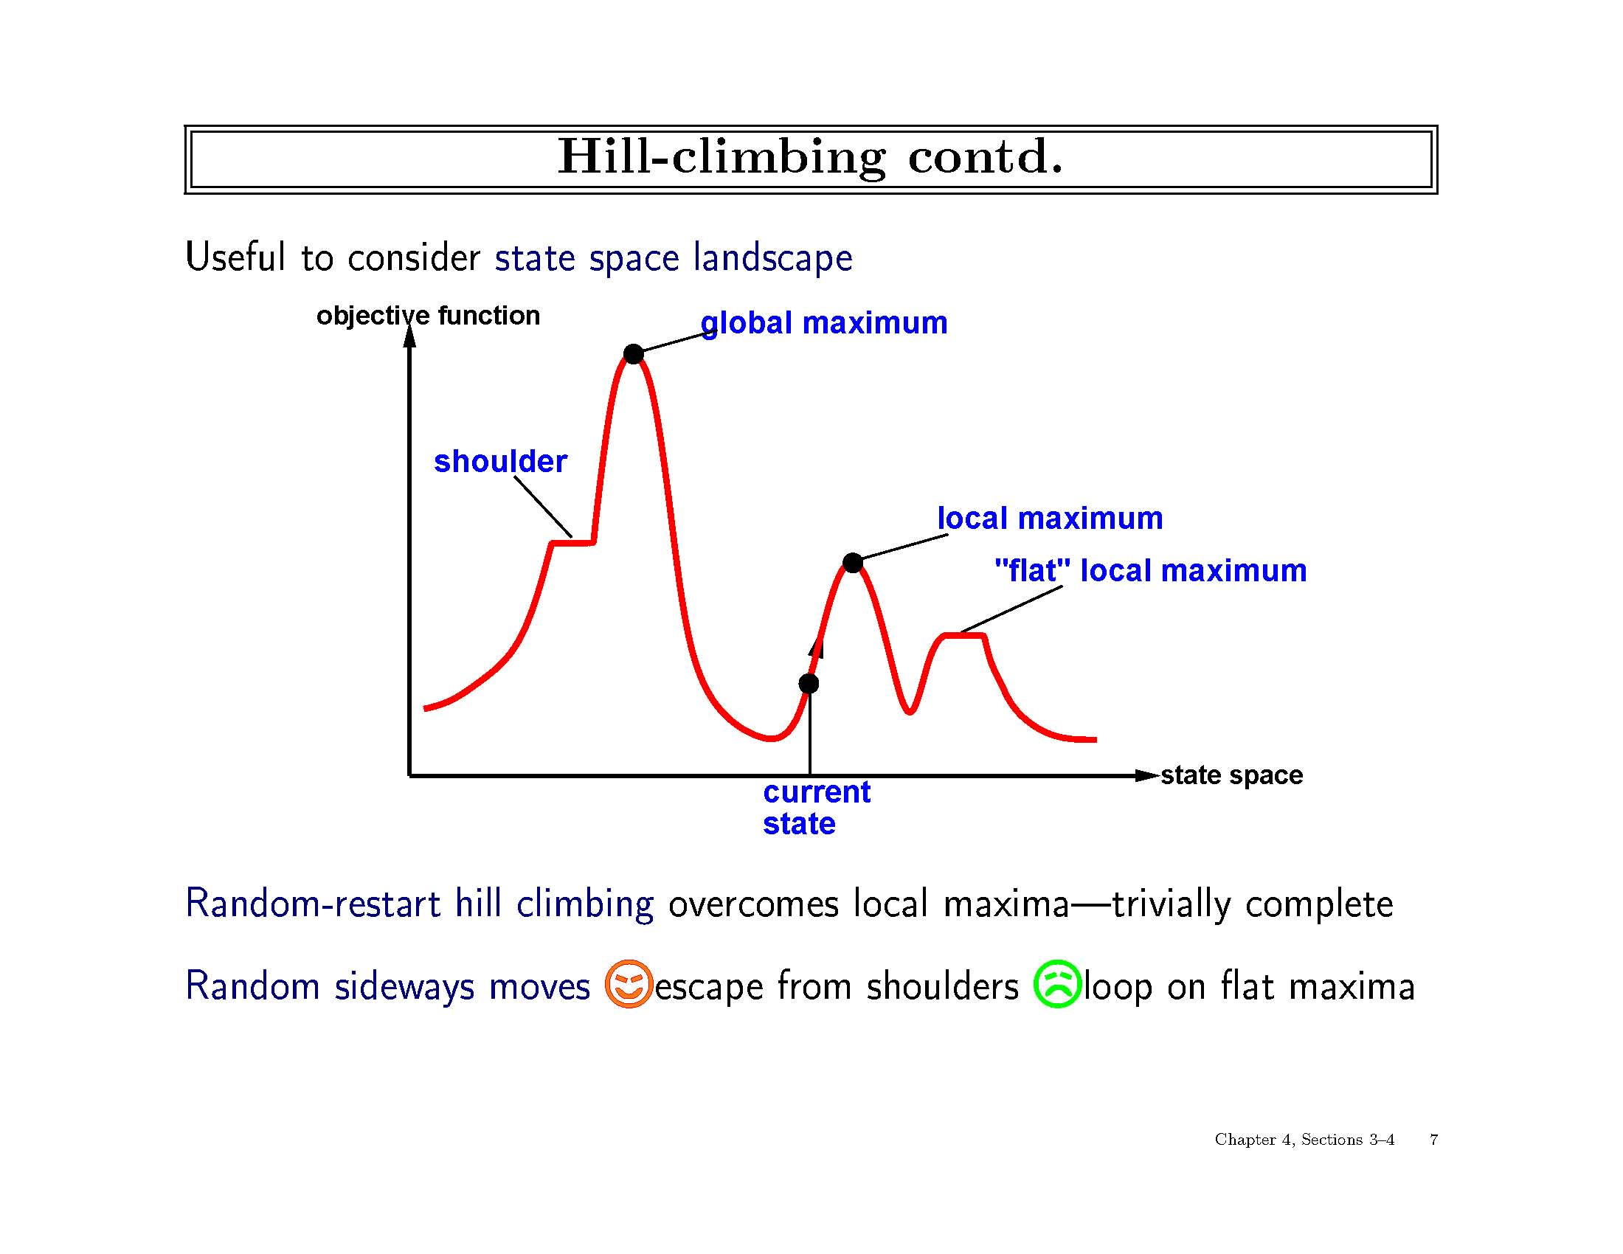

Slide 16
Simulated Annealing
Pure hill climbing is not complete, but pure random search is inefficient.
Simulated annealing offers a compromise.
Inspired by annealing process of gradually cooling a liquid until it changes to a low-energy state.
Very similar to hill climbing, except include a user-defined temperature schedule.
When temperature is “high”, allow some random moves.
When temperature “cools”, reduce probability of random move.
If T is decreased slowly enough, guaranteed to reach best state.

Slide 17
Genetic Algorithms
What is a Genetic Algorithm (GA)?
An adaptation procedure based on the mechanics of natural genetics and natural selection
Gas have 2 essential components
Survival of the fittest
Recombination
Representation
Chromosome = string
Gene = single bit or single subsequence in string, represents 1 attribute
Reproduction
Crossover
Mutation

Slide 18
THANK YOU

